Slide 1
Mail Simulation Application Development

Slide 2
Mail Simulation Application Development
BY :
Hari Vakkala
Akshata G. Nayak
Anitha Ramapuram
Deepesh Kumar Khandelwal
Ranjeet Kumar Jha
Ramesh

Slide 3
Problem Statement
People use to communicate through letters and telegram which is not faster . So mailing system got introduced to over come this problem .
Mail Simulation Application is an application where user can interact with each other through mail .

Slide 4
Objective
To simulate mailing system so users can communicate easily . This application will have users and those users can communicate through mail .
This will reduce time and increase efficiency

Slide 5
Technology And Tools
Technologies
Backend
Spring Boot With Hibernate
Frontend
Angular 7.0
Tools
Eclipse IDE 2019-09
Visual Studio Code

Slide 6
Modules
Register
Login
Change password
Sent Mail
Compose Mail
Inbox
Delete
Draft
Home

Slide 7
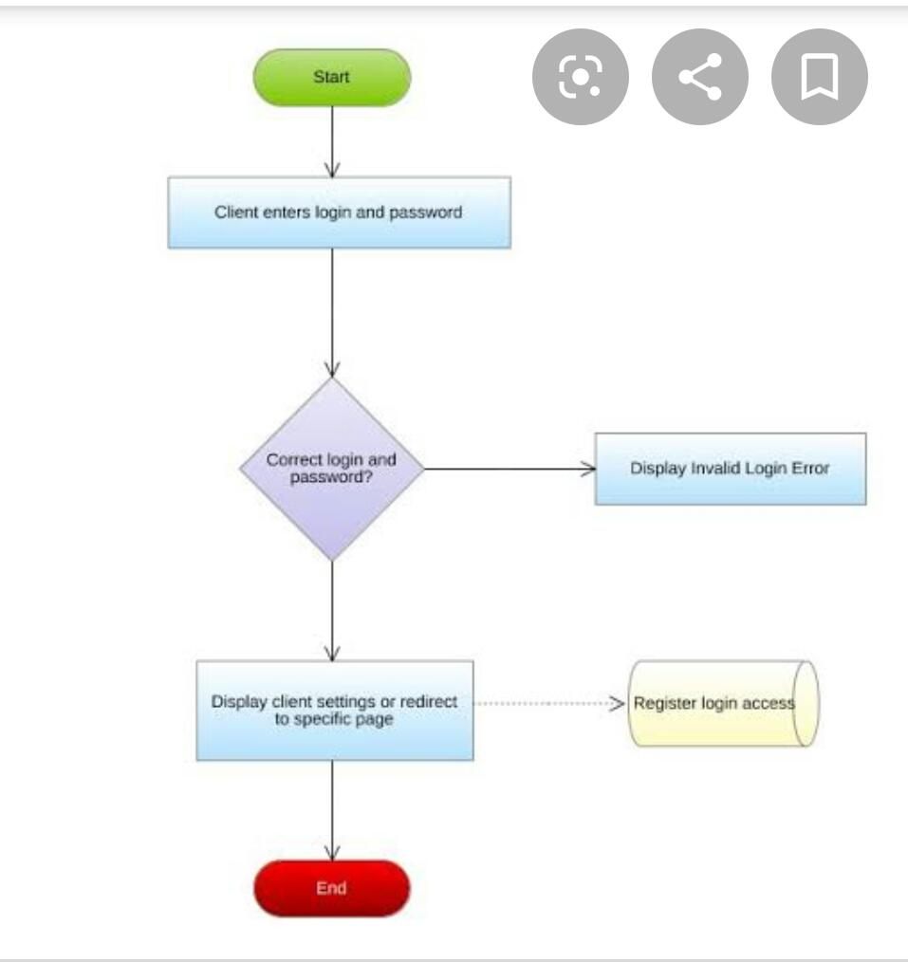
FlowChart

Slide 8
Roles
Hari Vakkala : Back end Login , Register , Forget Password
Akshata G. Nayak: Front end login , register , Forget Password
Anitha Ramapuram : Back end and front end Compose mail module
Deepesh Kumar Khandelwal : Back end and front end inbox module
Ranjeet Kumar Jha : Back end and front end draft , sent mail
Ramesh : Back end and front end delete , home modules

Slide 9


